Slide 1
Effect of Massive MIMO Technology on Energy Efficiency of the Wireless Cellular Network
Comparison with Standard MIMO Technology
Notes:
See notes under slides

Slide 2
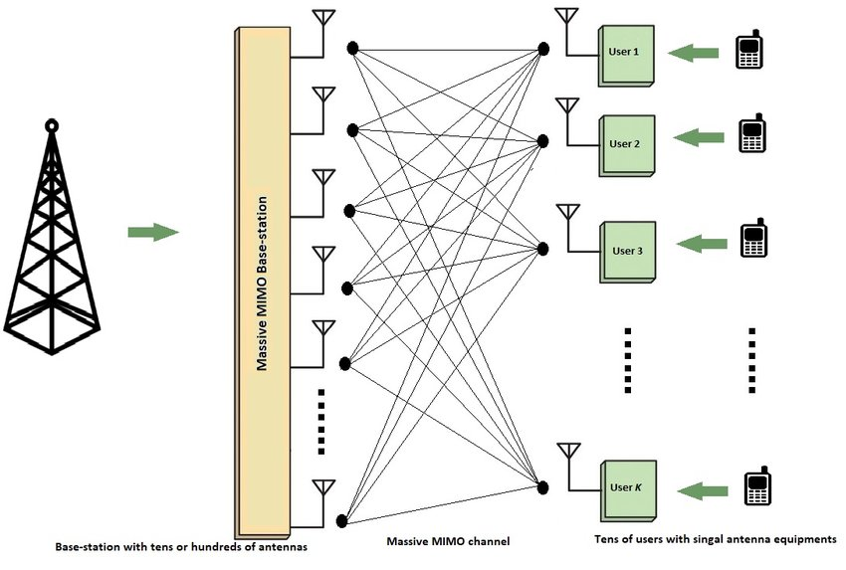
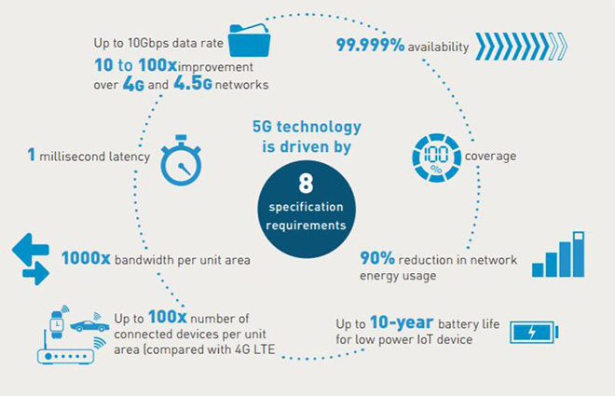
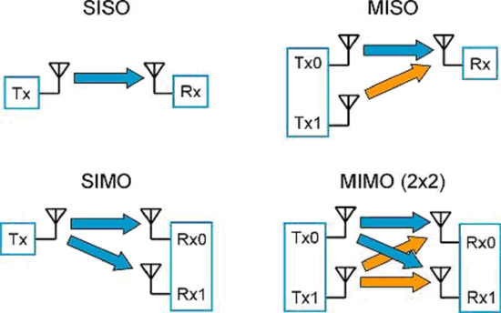

Key words
Wireless Cellular Networks (5G)
Energy Efficiency (EE)
Standard MIMO
Massive MIMO (MM)
Notes:
1- 5G spec requirements of IMT-2020
2- Energy efficiency means using less energy to get the same job done.
where R is the system throughput and P is the power spent in achieving R.
Total bits successfully transmitted by consuming a Joule of energy is called EE measured as bits-per-Joule.
EE is dependent on many factors, i.e., spectral efficiency, network architecture, power consumption by the entire system, and transmission protocol → Effect of MM on EE
3- MIMO: multiplying the capacity of a radio link using multiple transmission and receiving antennas
4- MM: Massive number of serving antennas at the BS. Based on 3 key tech: spatial diversity, spatial multiplexing, and beamforming.
Spatial diversity: transmit same message by multiple antennas to improve BER
Spatial multiplexing: MUX à message for one user on multiple antennas to improve data rate
Beamforming: faisceau d’ondes orientee vers l’utilisateur: Beam Multiple Division Access

Slide 3
Problem
Effect of Massive MIMO on Energy Efficiency (EE):
Sustainable evolution, carbon footprint, 5G requirements → challenges
Comparison with Standard MIMO level of EE
Notes:
Trade-off: EE and Area Throughput (bits/sec/km2)
in the 5G era with millions more base stations and billions of connected devices, given the required 1000x increasing in offered data rates and throughput, the network energy efficiency should be improved at least by the same factor, in order to maintain the whole energy consumption at today’s level.
Serving IoT devices (low power consumption)

Slide 4
Planning
Related work and research papers
Possible simulation
Report

